Slide 1
Find breast cancers in screening mammograms
By: Sachit Nair (20BRS1140) and Harisha S ( 20BRS1127)

Slide 2
Problem Statement
To build a model that is able to accurately identify the presence of breast cancer in a screening mammogram.
The goal of this challenge is to accurately identify instances of breast cancer by training a model with mammograms obtained from routine screenings. By improving the automation of mammogram analysis, we can help radiologists increase their accuracy and efficiency, leading to improved patient care that is both safe and of high quality. Additionally, this may result in reduced costs and fewer unnecessary medical procedures

Slide 3
Approach and Explanation

Slide 4
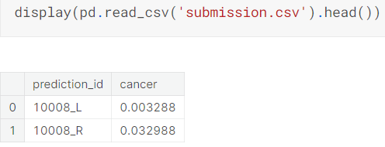
Code / Implementation
Kaggle Notebook Link
The above link contains the code that implements the approach. Run using GPUs. The output is of the form attached below:

Slide 5
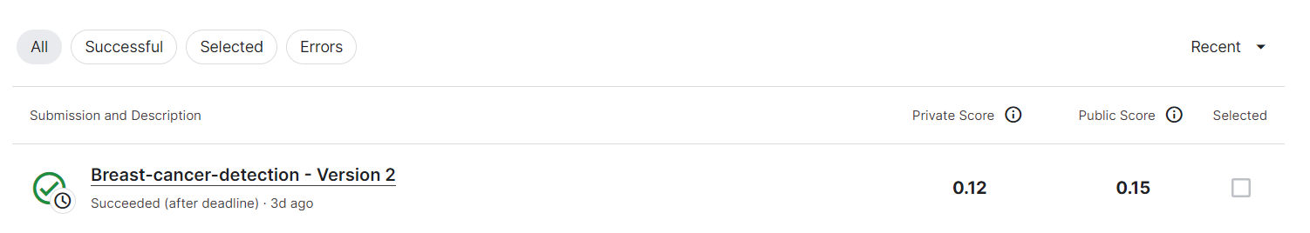
Submission Result

